Slide 1
Numerical Measures

Slide 2
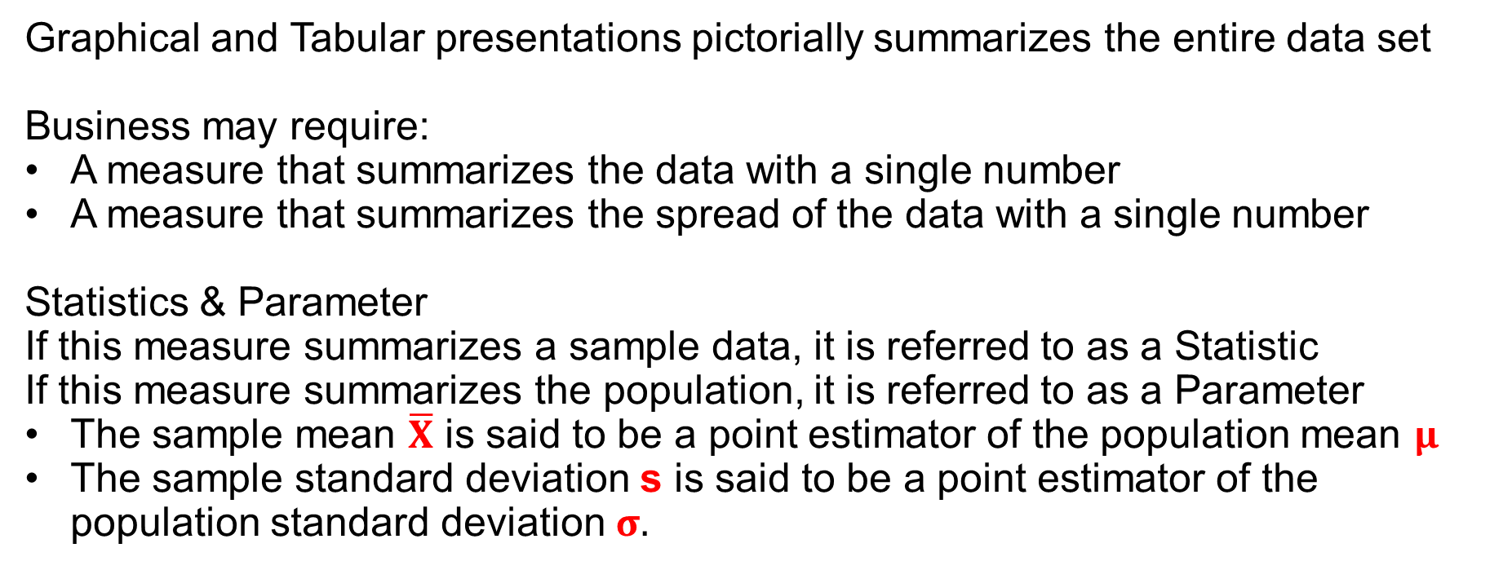
Numerical Measures – Location & Dispersion
Graphical and Tabular presentations pictorially summarizes the entire data set
Business may require:
A measure that summarizes the data with a single number
A measure that summarizes the spread of the data with a single number
Statistics & Parameter
If this measure summarizes a sample data, it is referred to as a Statistic
If this measure summarizes the population, it is referred to as a Parameter
The sample mean $\overline{X}$ is said to be a point estimator of the population mean $μ$
The sample standard deviation s is said to be a point estimator of the population standard deviation $σ.$

Slide 3
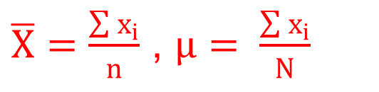
Measures of Location I
X | -2 | -2 | -1 | 0 | 1 | 5 |  | Y | -2 | -2 | -1 | 0 | 1 | 5 | 5
Mean 1/6 6/7
Median -0.5 = (-1+0)/2 0
Mode -2 -2, 5
$\overline{X}=\frac{\sum{x_{i}}}{n}$ , $μ= \frac{\sum{x_{i}}}{N}$

Slide 4
Mean Vs Median
Suppose the company knows it will retain customers if the customer satisfaction index is 6 or above (on a scale of 1 – 10.) The average index for the current survey is 6. Should the company feel comfortable?
Suppose the scores as 3 4 4 5 5 5 6 8 10 10
The shopkeeper maintains a record of the monthly spends by its regular customers. Would he be interested in the median spend or in the average spend?

Slide 5
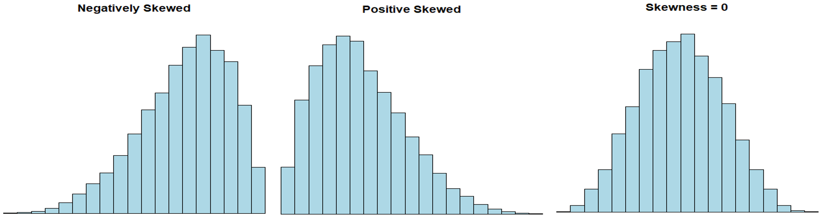
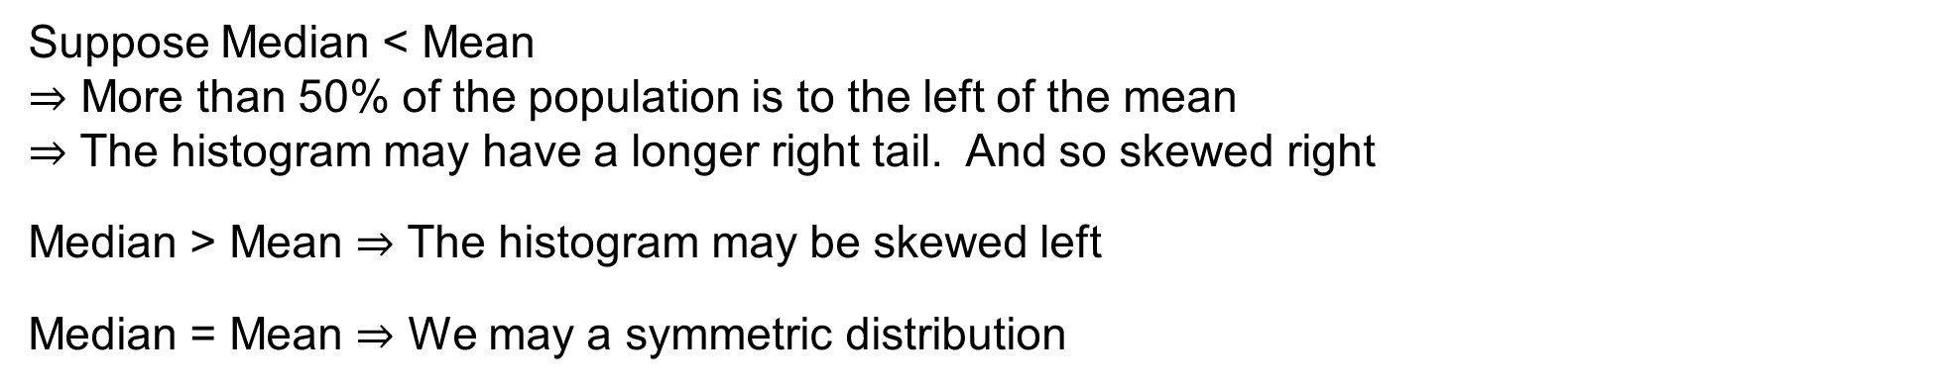
Skewness from Mean & Median
Suppose Median < Mean
$⇒$ More than 50% of the population is to the left of the mean
$⇒$ The histogram may have a longer right tail. And so skewed right
Median > Mean $⇒$ The histogram may be skewed left
Median = Mean $⇒$ We may a symmetric distribution

Slide 6
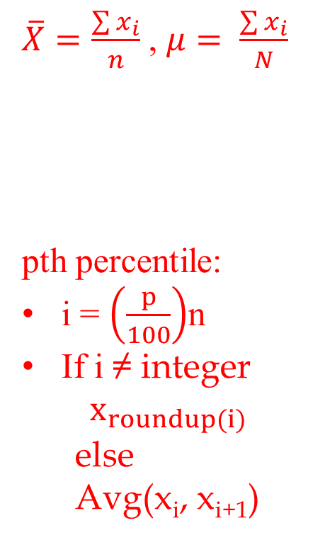
Measures of Location II
X | -2 | -2 | -1 | 0 | 1 | 5 |  | Y | -2 | -2 | -1 | 0 | 1 | 5 | 5
Mean 1/6 6/7
Median -0.5 = (-1+0)/2 0
Mode -2 -2, 5
Quartiles
Q3 (75%) 1 5
Q2 (50%) -0.5 0
Q1 (25%) -2 -2
$\overline{X}=\frac{\sum{x_{i}}}{n}$ , $μ= \frac{\sum{x_{i}}}{N}$
pth percentile:
i = $\left(\frac{p}{100}\right)$n
If i ≠ integer
$$x_{roundup(i)}$$
else
Avg(x_{i}, x_{i+1})

Slide 7
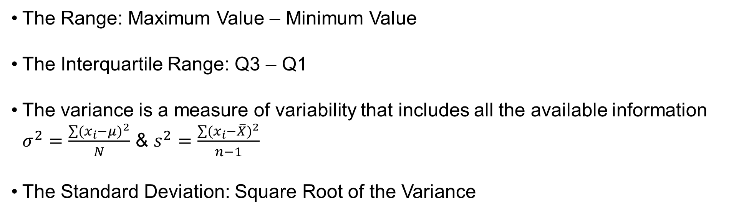
Measures of Dispersion
The Range: Maximum Value – Minimum Value
The Interquartile Range: Q3 – Q1
The variance is a measure of variability that includes all the available information
$σ^{2}=\frac{\sum{{(x_{i}−μ)}^{2}}}{N}$ & $s^{2}=\frac{\sum{{(x_{i}−\overline{X})}^{2}}}{n−1}$
The Standard Deviation: Square Root of the Variance

Slide 8
Example
X | -2 | -2 | -1 | 0 | 1 | 5
Min | -2
Q1 | -2
Q2 | -0.5
Q3 | 1
Max | 5
Range | 7
IQR | 3
Var | 6.97
Std Dev | 2.64
 | X | X - Mean | (X-Mean)²
 | -2 | -2.17 | 4.69
 | -2 | -2.17 | 4.69
 | -1 | -1.17 | 1.36
 | 0 | -0.17 | 0.03
 | 1 | 0.83 | 0.69
 | 5 | 4.83 | 23.36
SUM | 1 | 0 | 34.83
Mean | 0.17 | 0 | 6.97
VAR | 6.97
Notes:
Consider the data set X

Slide 9
Box Plot & Five-Number Summary & Outliers
FIVE NUMBER SUMMARY
X | -2 | -2 | -1 | 0 | 1 | 5
Min | -2
Q1 | -2
Q2 | -0.5
Q3 | 1
Max | 5
IQR | 3
1.5*IQR | 4.5
Upper Limit | Q3+1.5*IQR = 5.5
Lower Limit | Q1 – 1.5*IQR = -6.5
An outlier is any observation above the Upper Limit or below the Lower Limit

Slide 10
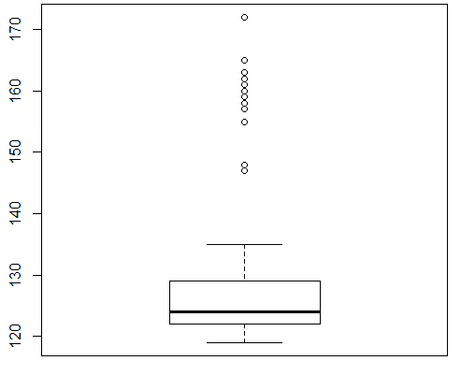
Kentucky Derby Data: Box Plot & Five-Number Summary & Outliers
FIVE NUMBER SUMMARY
X | Kentucky Derby
Min | 119
Q1 | 122
Q2 | 124
Q3 | 129
Max | 172
IQR | 7
1.5*IQR | 10.5
Upper Limit | 139.5
Lower Limit | 111.5

Slide 11
Takeaways
Measures of Location
Mean, Median, Mode, Percentiles and Quartiles
Measures of Dispersion
Range, IQR, Standard Deviation and Variance
Boxplots and the 5-Number Summary
Skewness and the Mean / Median Relationship

